Slide 1
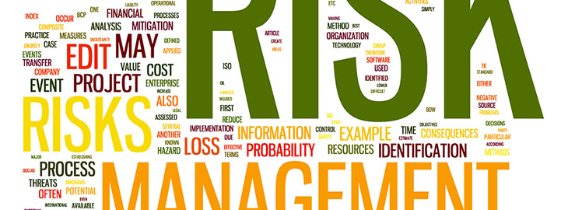
Software Risks

Slide 2
Risk is uncertain events associated with future events which have a probability of occurrence but it may or may not occur and if occurs it brings loss to the project.
Risk identification and management are very important task during software project development because success and failure of any software project depends on it.

Slide 3
There are three main classifications of risks which can affect a software project:
Project risks
  Schedule
  Budget
  Operational
Technical risks
Business risks

Slide 4
1. Project risks: Project risks concern differ forms of budgetary, schedule, personnel, resource, and customer-related problems.
A vital project risk is schedule slippage. Since the software is intangible, it is very tough to monitor and control a software project. It is very tough to control something which cannot be identified. For any manufacturing program, such as the manufacturing of cars, the plan executive can recognize the product taking shape.

Slide 5
Technical risks: Technical risks concern potential method implementation, interfacing, testing, and maintenance issue. It also consists of an ambiguous specification, incomplete specification, changing specification, technical uncertainty, and technical obsolescence. Most technical risks appear due to the development team's insufficient knowledge about the project.
Frequent changes in requirement
Less use of future technologies
Less number of skilled employee
High complexity in implementation
Improper integration of modules

Slide 6
Business risks: This type of risks contain risks of building an excellent product that no one need, losing budgetary or personnel commitments, etc.
Rapid development of market
Running out of fund / Limited fund for project development
Changes in Government rules/policy
Loss of contracts due to any reason

Slide 7
Schedule Risk :
Schedule related risks refers to time related risks or project delivery related planning risks. The wrong schedule affects the project development and delivery.
Time is not estimated perfectly
Improper resource allocation
Tracking of resources like system, skill, staff etc
Frequent project scope expansion
Failure in function identification and its’ completion

Slide 8
Budget Risk :
Budget related risks refers to the monetary risks mainly it occurs due to budget overruns. Always the financial aspect for the project should be managed as per decided
Wrong/Improper budget estimation
Unexpected Project Scope expansion
Mismanagement in budget handling
Cost overruns
Improper tracking of Budget

Slide 9
Operational Risks :
Operational risk refers to the procedural risks means these are the risks which happen in day-to-day operational activities during project development due to improper process implementation
Insufficient resources
Conflict between tasks and employees
Improper management of tasks
No proper planning about project
Less number of skilled people
Lack of communication and cooperation
Lack of clarity in roles and responsibilities
Insufficient training

Slide 10
Other risk categories
Known risks: Those risks that can be uncovered after careful assessment of the project program, the business and technical environment in which the plan is being developed, and more reliable data sources (e.g., unrealistic delivery date)
Predictable risks: Those risks that are hypothesized from previous project experience (e.g., past turnover)
Unpredictable risks: Those risks that can and do occur, but are extremely tough to identify in advance.

Slide 11
Reactive risk management tries to reduce the damage of potential threats and speed an organization’s recovery from them, but assumes that those threats will happen eventually.
Proactive risk management identifies threats and aims to prevent those events from ever happening in the first place.

Slide 12
reactive risk management strategies involves
Preventing potential risks from becoming incidents
Mitigating damage from incidents
Stopping small risks from worsening
Evaluating each incident to solve its root cause
Monitoring to ensure that the incident does not recur

Slide 13
Proactive risk management strategies include
Identifying existing risks to the enterprise, business unit, or project
Developing a risk response
Prioritizing identified risks according to the magnitude of their threat
Analyzing risks to determine the best treatment for each
Implementing necessary controls needed to prevent risks from becoming threats or incidents
Monitoring the threat environment continuously.

